Slide 1
Chapter 2: Introduction to Relational Model

Slide 2
Structure of Relational Databases
Tables
Attribute
Record
Tuples
Relation
Relation instance

Slide 3
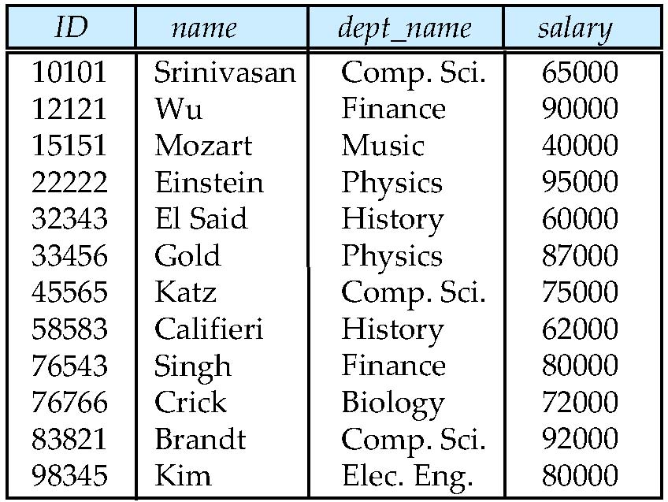
Example of a Relation- Instructor relation
attributes
(or columns)
tuples
(or rows)

Slide 4
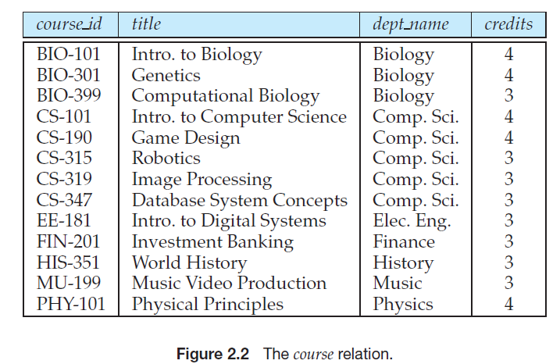

Slide 5
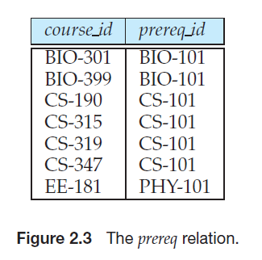

Slide 6
Attribute Types
The set of allowed values for each attribute is called the domain of the attribute
Attribute values are (normally) required to be atomic; that is, indivisible
Null value- unknown, not exist.

Slide 7
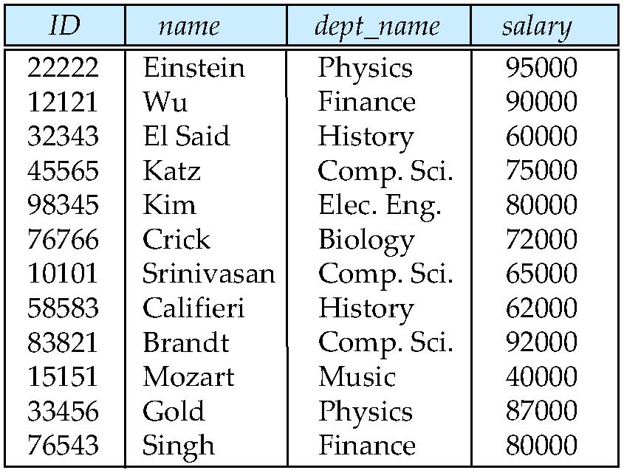
Relations are Unordered
Order of tuples is irrelevant (tuples may be stored in an arbitrary order)
Example: instructor relation with unordered tuples

Slide 8
Database Schema
Database schema -logical design of the database, and the
database instance- is a snapshot of the data in the database at a given instant in time.
a relation schema consists of a list of attributes and their corresponding domains.
we often use the same name, such as instructor, to refer to both the schema and the instance.
Where required, we explicitly refer to the schema or to the instance, for example “the instructor schema,” or “an instance of the instructor relation.”

Slide 9
Schema of the university database
classroom(building, room number, capacity)
department(dept name, building, budget)
course(course id, title, dept name, credits)
instructor(ID, name, dept name, salary)
section(course id, sec id, semester, year, building, room number, time slot id)
teaches(ID, course id, sec id, semester, year)
student(ID, name, dept name, tot cred)
takes(ID, course id, sec id, semester, year, grade)
advisor(s ID, i ID)
time slot(time slot id, day, start time, end time)
prereq(course id, prereq id)

Slide 10
Database
A database consists of multiple relations
Information about an enterprise is broken up into parts
instructor student advisor
Bad design: univ (instructor -ID, name, dept_name, salary, student_Id, ..) results in
repetition of information (e.g., two students have the same instructor)
the need for null values (e.g., represent an student with no advisor)
Normalization theory (Chapter 7) deals with how to design “good” relational schemas

Slide 11
Keys
Attribute values of a tuple must be such that they can uniquely identify the tuple.
No two tuples in a relation are allowed to have exactly the same value for all attributes.
A superkey is a set of one or more attributes that, taken collectively, allow us to identify uniquely a tuple in the relation.
For example, the ID attribute of the relation instructor is sufficient to distinguish one instructor tuple from another. Thus, ID is a superkey.
The name attribute of instructor, on the other hand, is not a superkey, because several instructors might have the same name.
no two distinct tuples have the same values on all attributes in K.
That is, if t1 and t2 are in r and t1 ≠ t2, then t1.K ≠ t2.K.

Slide 12
Keys
Let K ⊆ R
K is a superkey of R if values for K are sufficient to identify a unique tuple of each possible relation r(R)
Example: {ID} and {ID,name} are both superkeys of instructor.
Superkey K is a candidate key if K is minimal Example: {ID} is a candidate key for Instructor
One of the candidate keys is selected to be the primary key.
which one?
Foreign key constraint: Value in one relation must appear in another
Referencing relation
Referenced relation

Slide 13
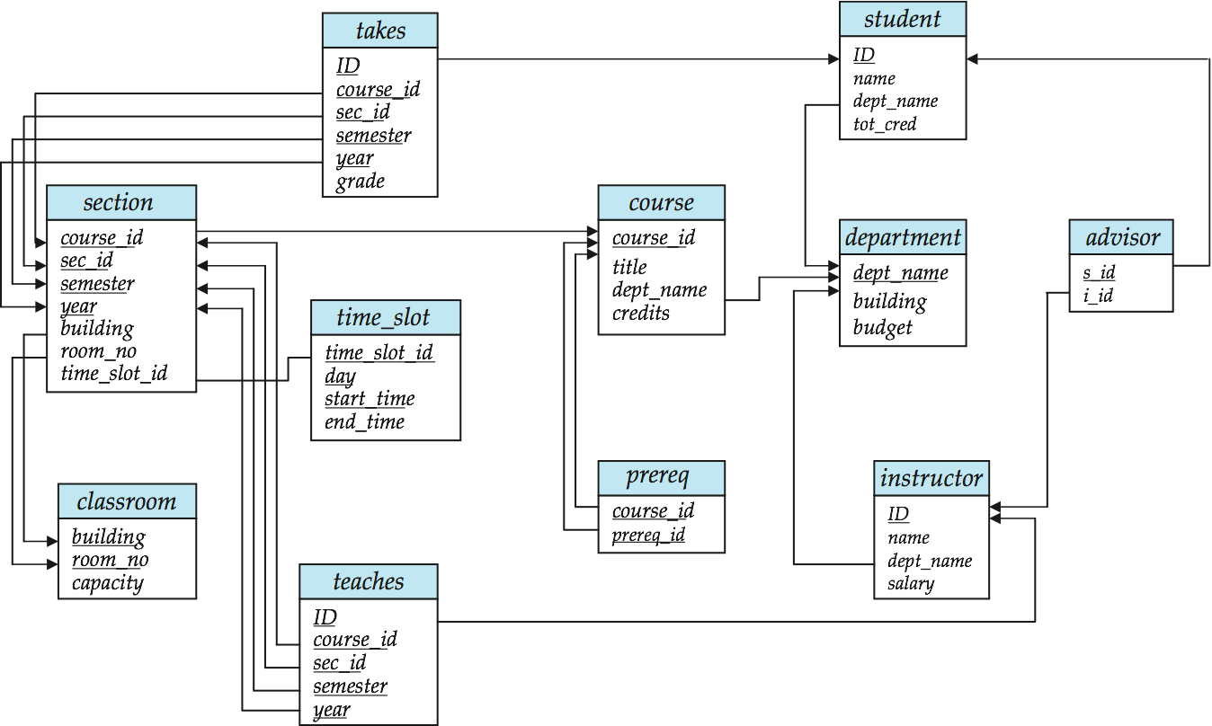
Schema Diagram for University Database

Slide 14
Department -Relation

Slide 15
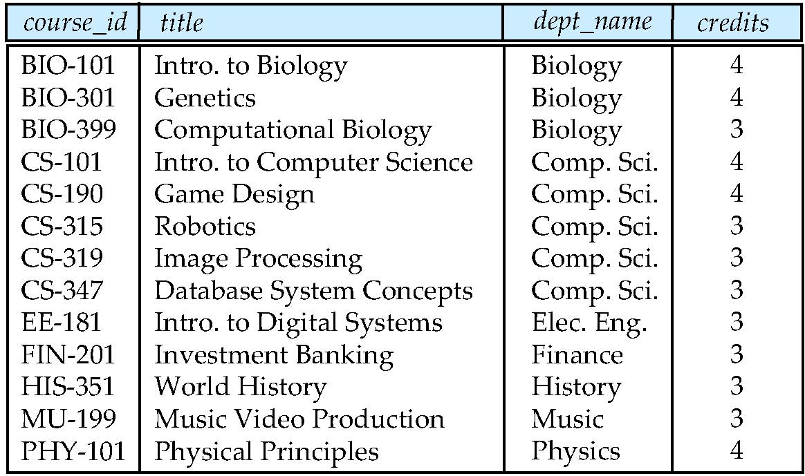
Figure 2.02 –course relation

Slide 16
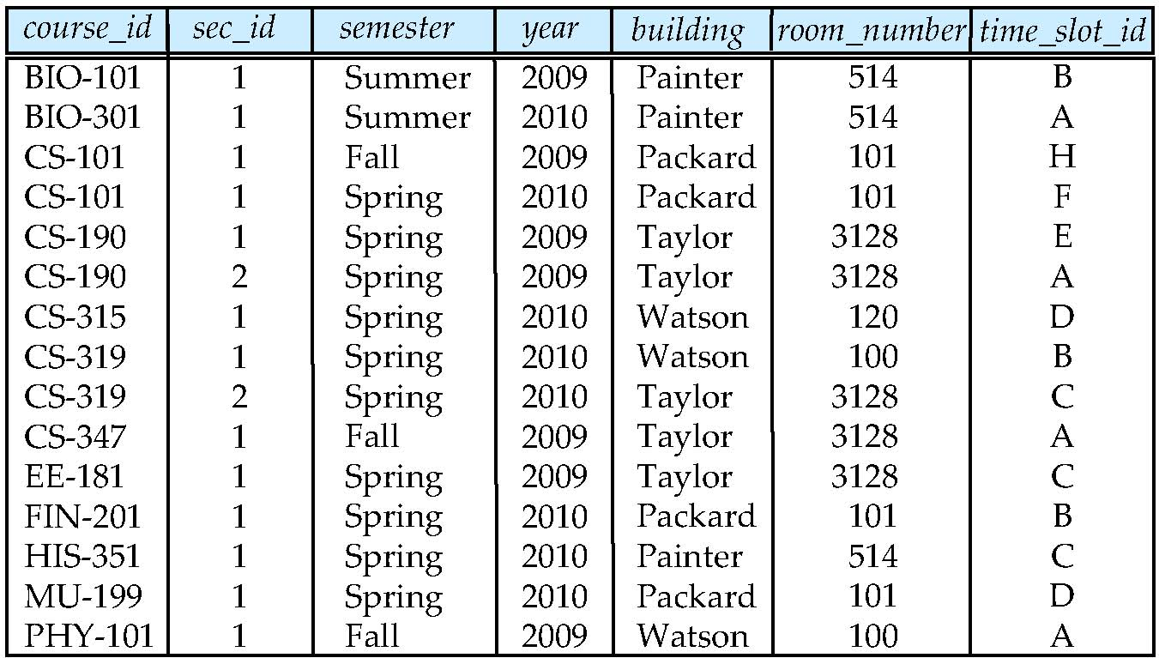
Figure 2.06-Section Relation

Slide 17
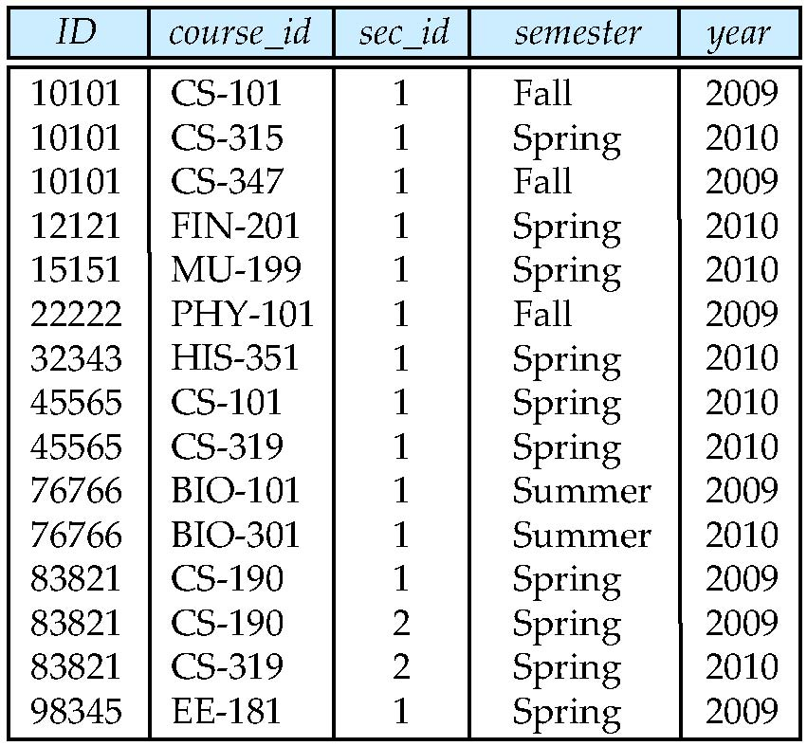
Figure 2.07 –Teaches relation
Teaches

Slide 18
Relational Query Languages
Procedural vs.non-procedural, or declarative
“Pure” languages:
Relational algebra
Tuple relational calculus
Domain relational calculus
Relational operators

Slide 19
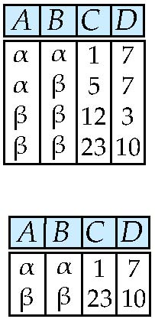
Selection of tuples
Relation r
Select tuples with A=B and D > 5
σ _{A=B and D > 5} (r)

Slide 20
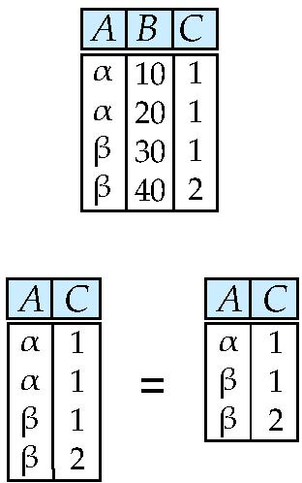
Selection of Columns (Attributes)
Relation r:
Select A and C
Projection
Π _{A, C} (r)

Slide 21
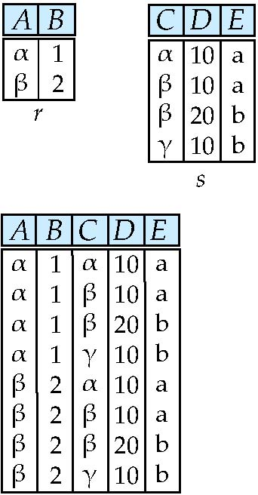
Joining two relations – Cartesian Product
Relations r, s:
r x s:

Slide 22
Joining two relations – Natural Join
Let r and s be relations on schemas R and S respectively. Then, the “natural join” of relations R and S is a relation on schema R ∪ S obtained as follows:
Consider each pair of tuples t_{r} from r and t_{s} from s.
If t_{r} and t_{s} have the same value on each of the attributes in R ∩ S, add a tuple t to the result, where
t has the same value as t_{r} on r
t has the same value as t_{s} on s

Slide 23
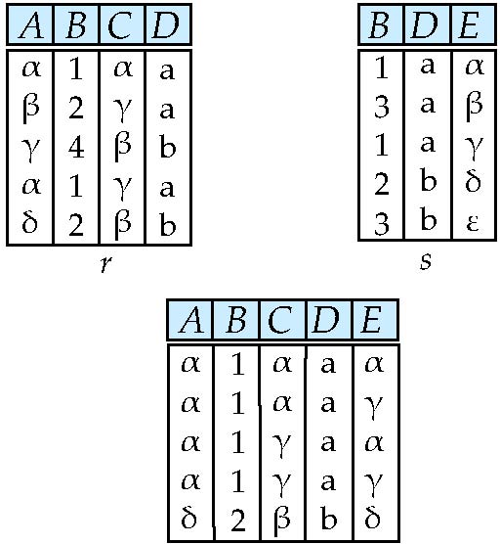
Natural Join Example
Relations r, s:
Natural Join
r s

Slide 24
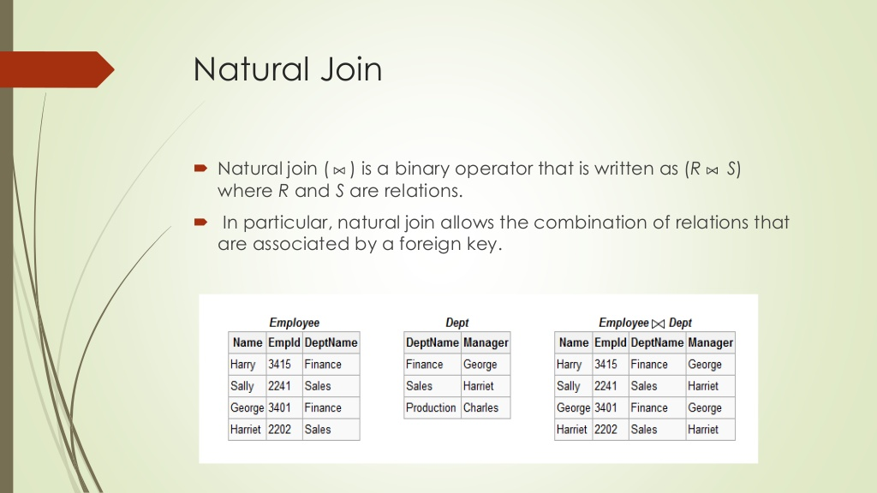

Slide 25
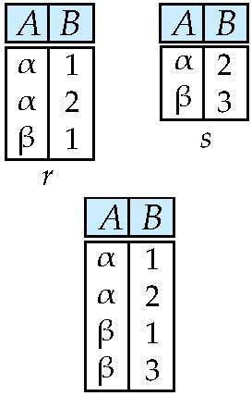
Union of two relations
Relations r, s:
r ∪ s:

Slide 26
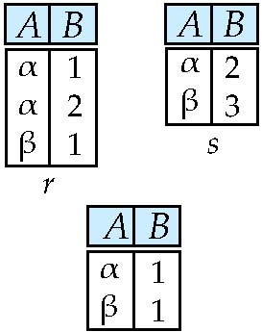
Set difference of two relations
Relations r, s:
r – s:

Slide 27
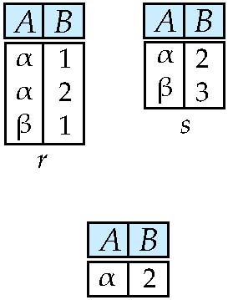
Set Intersection of two relations
Relation r, s:
r ∩ s

Slide 28
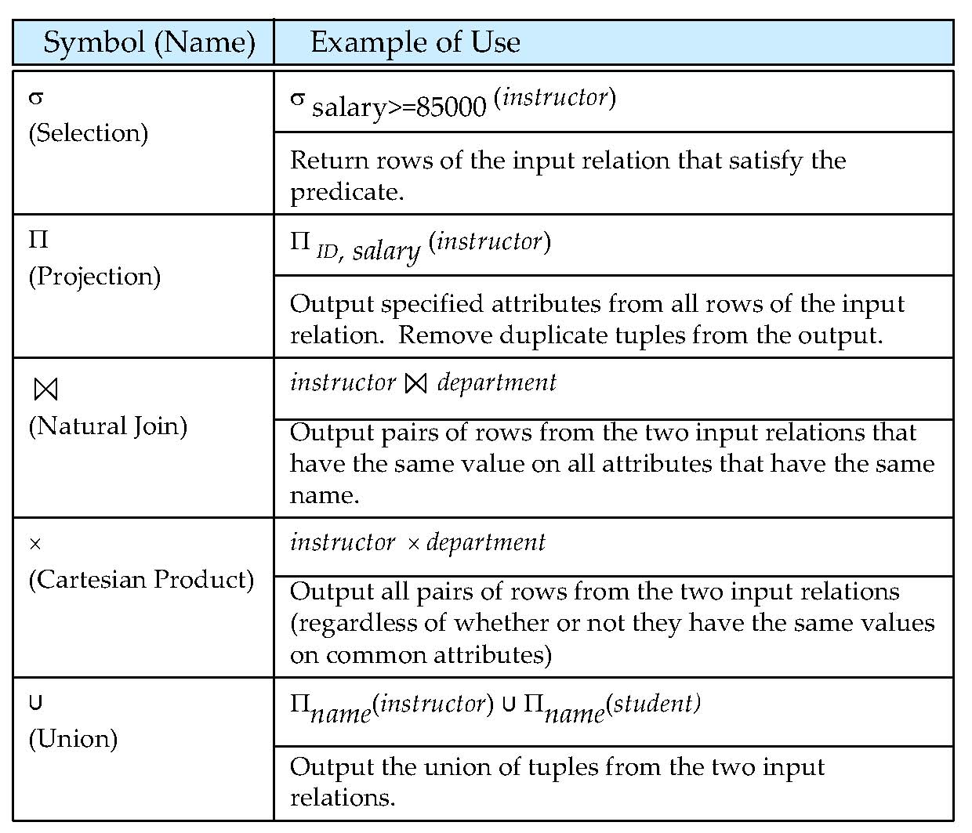
Figure in-2.1

Slide 29
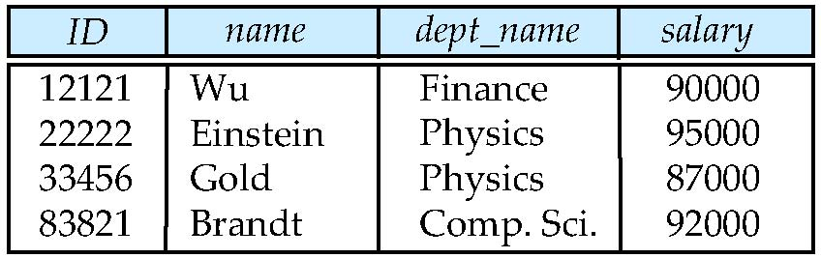
SELECT -Query

Slide 30
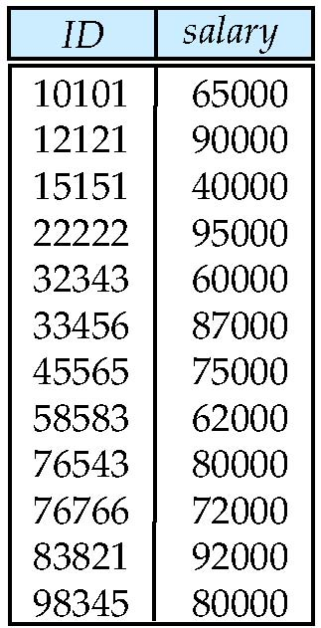
PROJECT

Slide 32
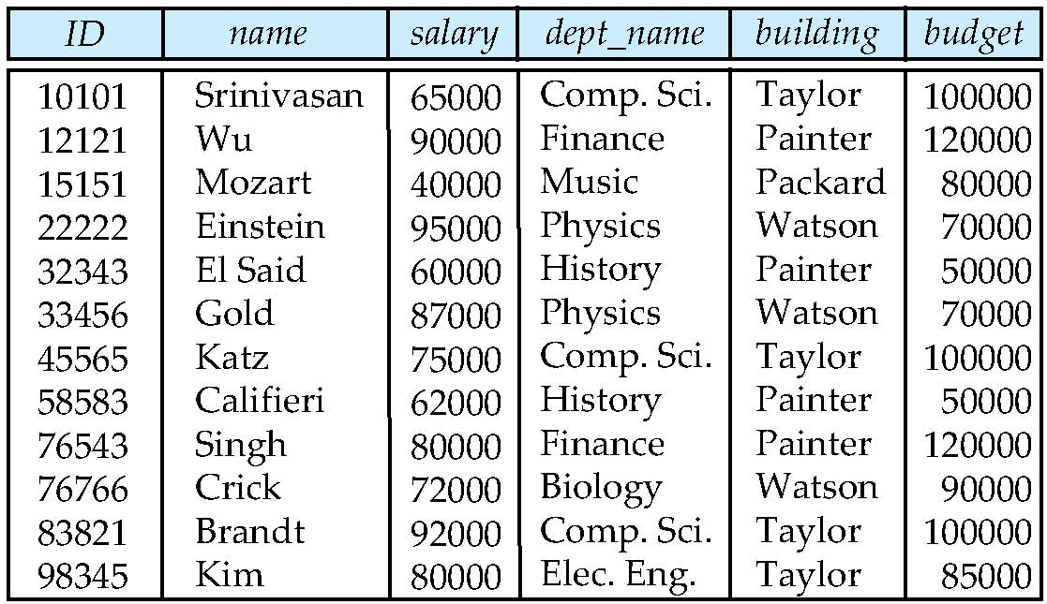
Natural Join

Slide 33
End of Chapter 2

